Slide 1
Cisco Japan’s Activities in IPv6 Promotion Council
Tetsuya Innami
Cisco Systems
Co-Chair, IPv6 Home Router SWG
IPv6 Promotion Council, Japan
June 16th, 2011
APrIGF in Singapore

Slide 2
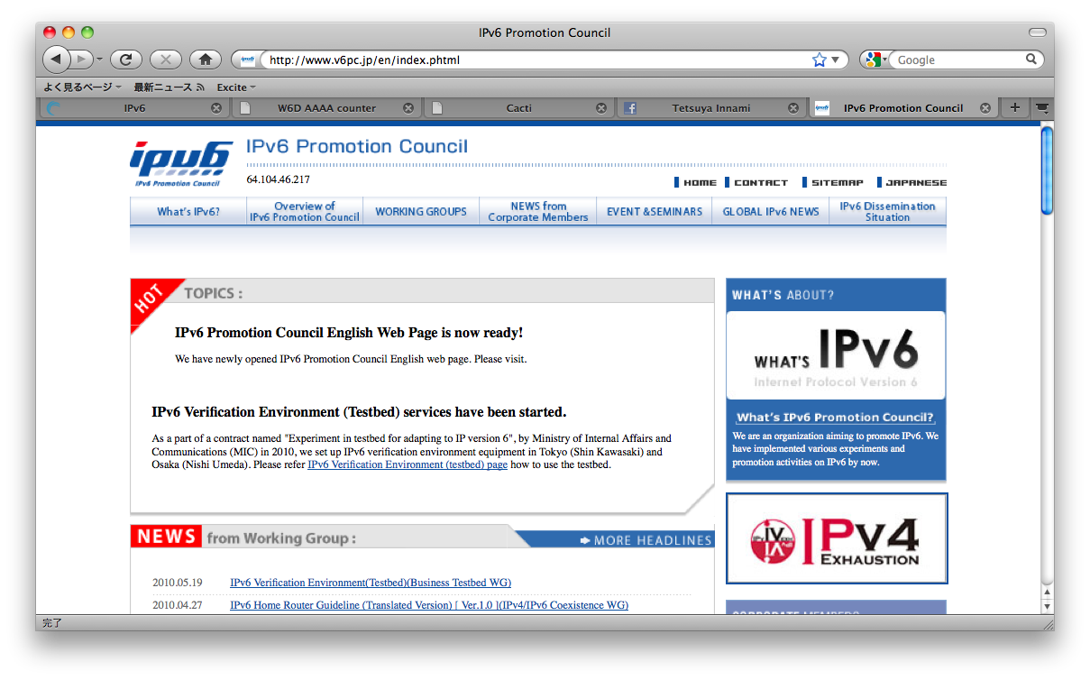
The IPv6 Promotion Council
Aiming at:
Pursuing an international leadership.
Developing rich human resource.
Promoting new business and Vitalizing existing business.
http://v6pc.jp/
a non-profitable organization
Established in October, 2000
200+ members (Orgs and Individuals)

Slide 3
Organization
Working Groups of the IPv6 Promotion council
Education and Prototyping
http://www.v6pc.jp/en/wg/index.phtml

Slide 4
Activities of Business Learning and Testbed WG
Business Learning WG
Prototype the education program on IPv6 tech and ops at members’ events
Allow commercial training providers to deploy it
Request the technical certificate programs to include IPv6 contents
1st Hands-on training in September, 2009 – Sold out in a single day!
Hands-on Training was done for more than 600 people in 2010
Business Testbed WG
MIC’s FY2009/2010 budget for constructing a testbed
Nation-wide network + testbed center for any stakeholders to try on IPv6
Testbed Center has launched in Keio’s K2 Campus
Testbed was used by a variety of industries, like consumer electronics company, ISPs, Cable TV operators, security operation vendors.
Notes:
4

Slide 5
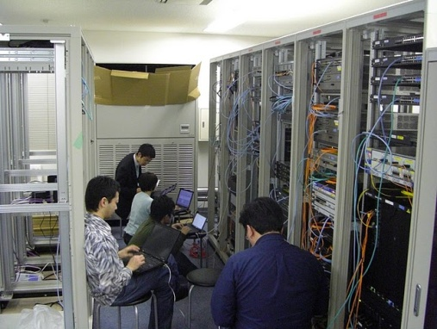
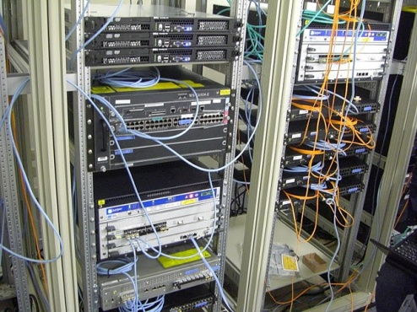
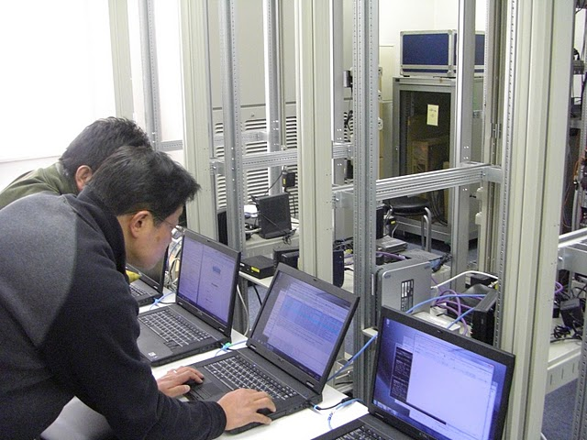
Overview of the Testbed
Organized by Learning and Testbed WG
Purpose
Simulate the IPv4 exhaustion environment
Conduct IPv6 verification tests
Establish transition procedures under various conditions
Two testbeds in Japan
Keio University Shin-Kawasaki Campus
Broadband Tower Data Center in Osaka

Slide 6
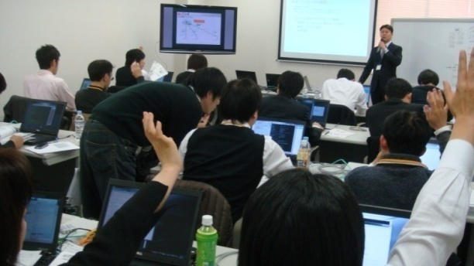
IPv6 Hands-on Seminars
Human resource development to support the integration of IPv6 technologies
Conducting more than 10 IPv6 hands-on seminars all over Japan from 2009-2010
more than 600 participants in 2010
Topics
ISP Network (Alaxala)
iDC Network (Cisco)
ISP/iDC/CATV/SOHO Servers (NEC)
CATV Network (Cisco & ARRIS)
IPv6 Multicast (Alcatel-Lucent, Alaxala, Cisco)
Networking Basics (Cisco/Alaxala)
Outputs
Multi-vendor PDF Materials in Japanese / English http://www.kokatsu.jp/blog/ipv4/en/data/ipv6-hs-materials-en.html

Slide 7
Organization
Working Groups of the IPv6 Promotion council
Discussing features of IPv6 Home Routers
http://www.v6pc.jp/en/wg/index.phtml

Slide 8
Background of IPv6 Home Router SWG
In 2008
NTT East and West planned to provide IPv6 access services between residential users and ISPs over their NGNs.
In Japan, Most ISPs depend on NTT’s “Flets” access services to gain the coverage for the residential users on IPv4, then those for IPv6 have been released in 2011.
There was no place to discuss about IPv6 CPEs in Japan at that time.
Some foreign organization had been starting these items(Cable Lab., IETF, Broadband Forum,…).
We need to localize the specification in order to help the CPE vendors for Japanese market.

Slide 9
IPv6 Home Router SWG
The SWG was formed by about 30 members in September, 2008.
Co-work with the IPv4 Address exhaustion Task Force (Access Network WG).
Co-chairs (as of June, 2011) are:
Tomohiro Fujisaki (NTT Corporation)
Akira Nakagawa (Japan Internet Exchange)
Tetsuya Innami (Cisco Systems)

Slide 10
IPv6 Home Router SWG
Objectives
To bring together the minimum common functions of the IPv6 Home Router, which can connect the IPv6 Internet smoothly.
To clarify the requirements which conforms the access service/IPv6 Internet service in Japan.
To publish the document that summarizes the studies conducted by this SWG.

Slide 11
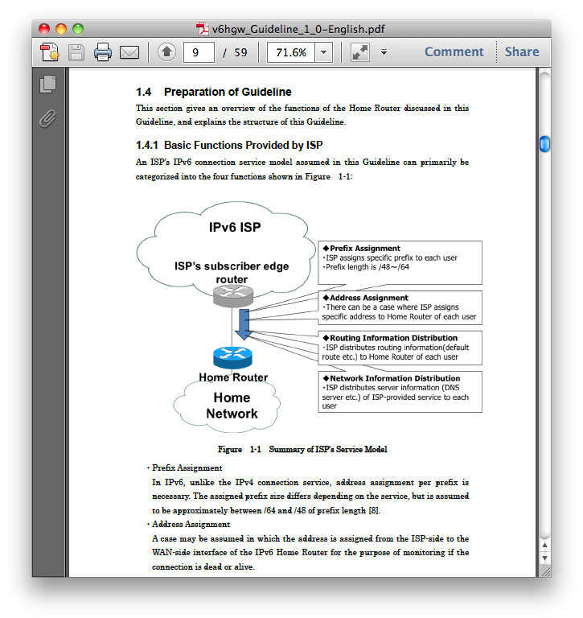
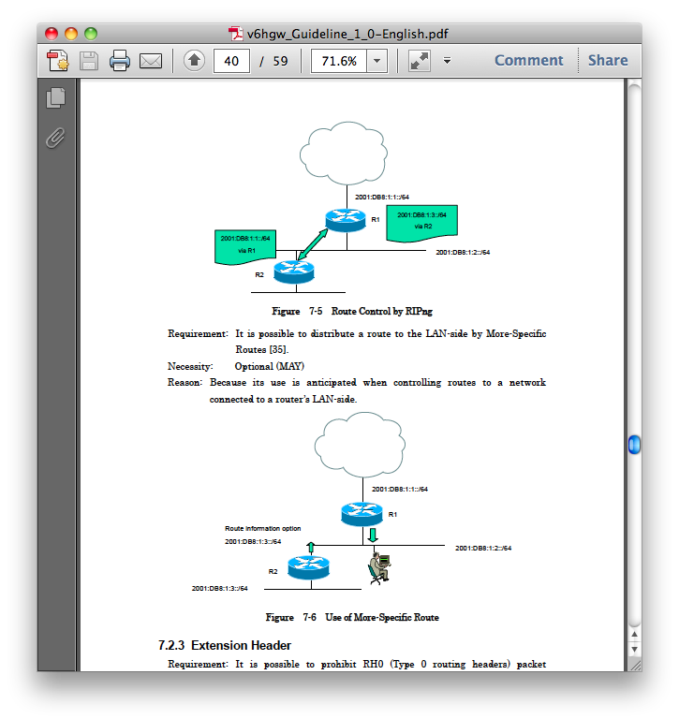
IPv6 Home Router Guideline, Release 1.0
Published in June, 2009
Summarizes minimum common features required by IPv6 Home Routers.
Many public comments are adapted.
Originally written in Japanese and English translated version is also available.
English version: http://www.v6pc.jp/pdf/v6hgw_Guideline_1_0-English.pdf

Slide 12
Topics of Release 1.0 contents
Access Line
Address Assignment/Delegation
Access Control
DNS
LAN Configuration
Unicast/Multicast Routing
For more detail, see: http://www.v6pc.jp/pdf/v6hgw_Guideline_1_0-English.pdf

Slide 13
IPv6 Home Router Guideline, Release 2.0
Published in July, 2010
A lot of improvements.
Twice number of pages(?) ☺
Additional section which describes the use case of NTT-NGN IPv6 access services.
Sorry,,, Only Japanese version available today.
English version is work in progress. It may be published in few months.
Notes:
ページ数が２倍です。

Slide 14
Next step…
Comparing with others, and clarifying the differences.
TR-124, “Functional Requirements for Residential Gateway Device”, issue 2, Broad Band Forum
RFC 6204, “Basic Requirements for IPv6 Customer Edge Router”, IETF
IPv6 Ready Logo, “Interoperability Test Scenario, CE Router” (phase-2), IPv6 Forum/UNH-IOL

Slide 15
World IPv6 Day in Japan
Achievement of IPv6 Promotion Council
Promoted the “v6 DAY” event in Japan.
IPv6 Promotion Council, Internet Association of Japan (IAjapan), ISOC Japan local chapter (rejuvenating) and WIDE project did press release for the Word IPv6 Day.
See: http://www.kokatsu.jp/blog/ipv4/en/news/2011/04/ispworld-ipv6-dayhtml.html
Japan Internet Providers Association (JAIPA) has urged correspondence on ISPs in Japan with us.
Mediated between the participants and ISOC.
Joint effort with the Internet Association of Japan
23 Japanese participants thru us
(67 sites / 60 organizations)

Slide 16
World IPv6 Day in Japan
The Result
A lot of people in Japan are analyzing the data measured on June 8th.
Some ISPs got gained much greater IPv6 Traffic!
There might be no major disruption for local residential users.
In Japan, the “Fallback Problem” is even severer than other countries.
IAjapan is planning to do survey to the v6 Day participants.
http://www.iajapan.org/ipv6/about_w6d.html (in Japanese, Its English version will be available)
May the Next World IPv6 Day be coming soon…!?
Notes:
フレッツの話しは口頭で言う。

