Slide 1
Cybersecurity, Privacy and Data Protection
June 2011:
APAC Regional Internet Governance Forum

Slide 2
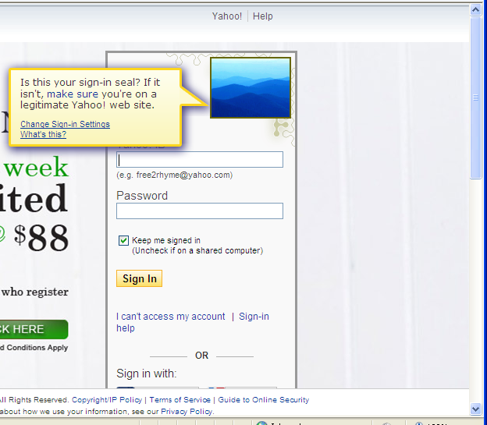
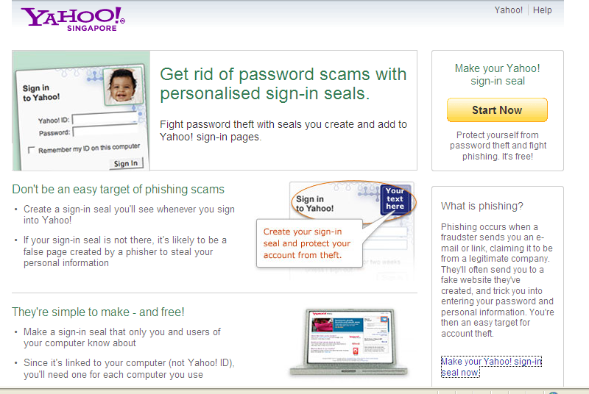
Security: Sign-in seal

Slide 3
Privacy Policies vs Layered Centres–
Highlighting User Control
Long legal statements are improved by using
layered notices, where users can choose the topics of most interest to them through simple navigation

Slide 4
Privacy Policies vs Privacy Centres–
Highlighting User Control Through Layers

Slide 5
Privacy by Design Reflected in Context of Products: Example for Singapore Answers

Slide 6
Privacy by Design Reflected in Advertising Choices: Example for Singapore Customization

Slide 7
The Role of Self-Regulation for Privacy Technology Enhancements Globally
Cross-industry collaboration for consistent user experiences critical for many contemporary privacy issues
  Ad networks, Advertisers, Agencies, Publishers
Codes of Conduct and best practice work can be useful
  NAI, IAB US-AAAA-ANA-DMA-BBB, IAB UK, IAB FR, FDI, IAB EU,
  WFA, MMA
Preserves ongoing enhancements (legal privacy principles can be applied organically to new technology)
Allows industry leadership and makes outliers easier to identify

