Slide 1
Disaster & Internet
Japan Internet Provider association
Toshiaki Tateishi

Slide 2
Many telecom station were broken by the Earthquake and Tsunami
Many lives could have been saved if the information system was active.
The subject is how we activate the infrastructure for 72 hrs after the disaster occurred.

Slide 3
The day when earthquake occurred
Off course, the power is down, we can not use internet ・・・
In Tokyo at that time everything was OK but railways.
Many people could not go back home, so bunch of people on the road.
Mobile phone was not available.
Except long distance call
In Tokyo
Skype was very useful
By Twitter, we could get some useful information
Rest places, food, rail way recovery

Slide 4
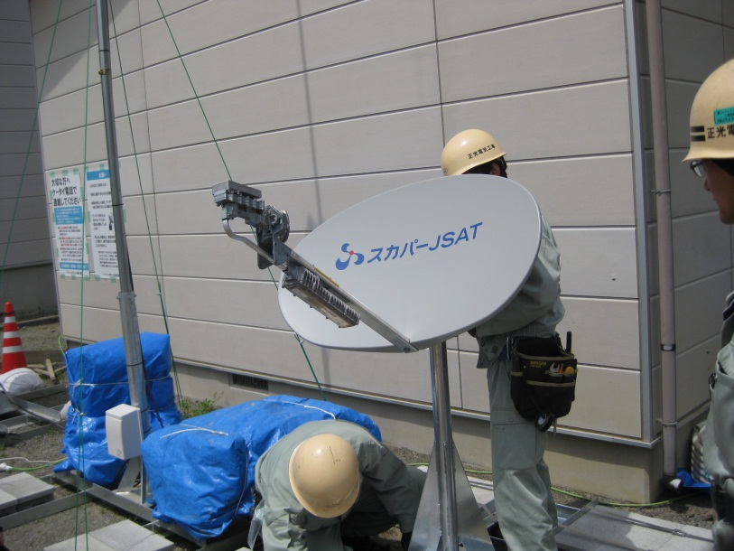
For recovery
Satellite Internet is very helpful
Only power supply is needed. We can use Internet and IP Phone around there.
Many mobile station were recovered by Sattellite
NTT, au, Softbank, e-mobile …
Merit and Demerit
Only power supply
Take much time to set
Not broadband

Slide 5
East and West Japan
3 days … after 3.11
On TV, just impressionable movies
We could not get the information from other places around the TSUNAMI
We still have earthquakes in east Japan as aftershock
But west Japan, there were none…
How we inform the people of the situation which the TV does not report

Slide 6
Be prepared
Redundancy route
Running cost is a big problem
We need some application(software) for every time and emergency time
We share the cost
For example, Web camera
In peace time
For sightseeing, fishing and surfing
In an emergency, it can monitor
Typhoon, tsunami etc.

Slide 7
From now
We have to have alternate way to access the internet
Which is automatically switched, is best
In Japan, the IX is only in Tokyo
We need some application or common API for emergency time.

